Slide 1
Introduction to Computer Programming

Slide 2


Today's Learning Objectives
Introduction to Computer Programming
Inside a Computer Program
How does a computer program work?
Understanding Source Code and Syntax
Understanding Data Types
Understanding Variables

Slide 3
Introduction to Computer Programming

Slide 4

Computer Programming
Computer programming is the process of writing a set of instructions that tell a computer how to process data and produce results.
INPUT
OUTPUT

Slide 5
Binary Code
Microprocessors (CPUs) understand a special kind of language known as Machine Code, which is made up of Binary numbers.
Binary numbers are made up of two states:​
0/Off/True
1/On/False
Combinations of binary numbers are used to express data and operations.​

Slide 6

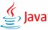

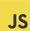


Computer Languages
Humans understand high-level languages and work with these languages to write computer programs that are ultimately converted to low-level machine code.​
Examples of high-level languages:
Java
Python
C++
JavaScript
Ruby
Rust

Slide 7
Inside a Computer Program

Slide 8
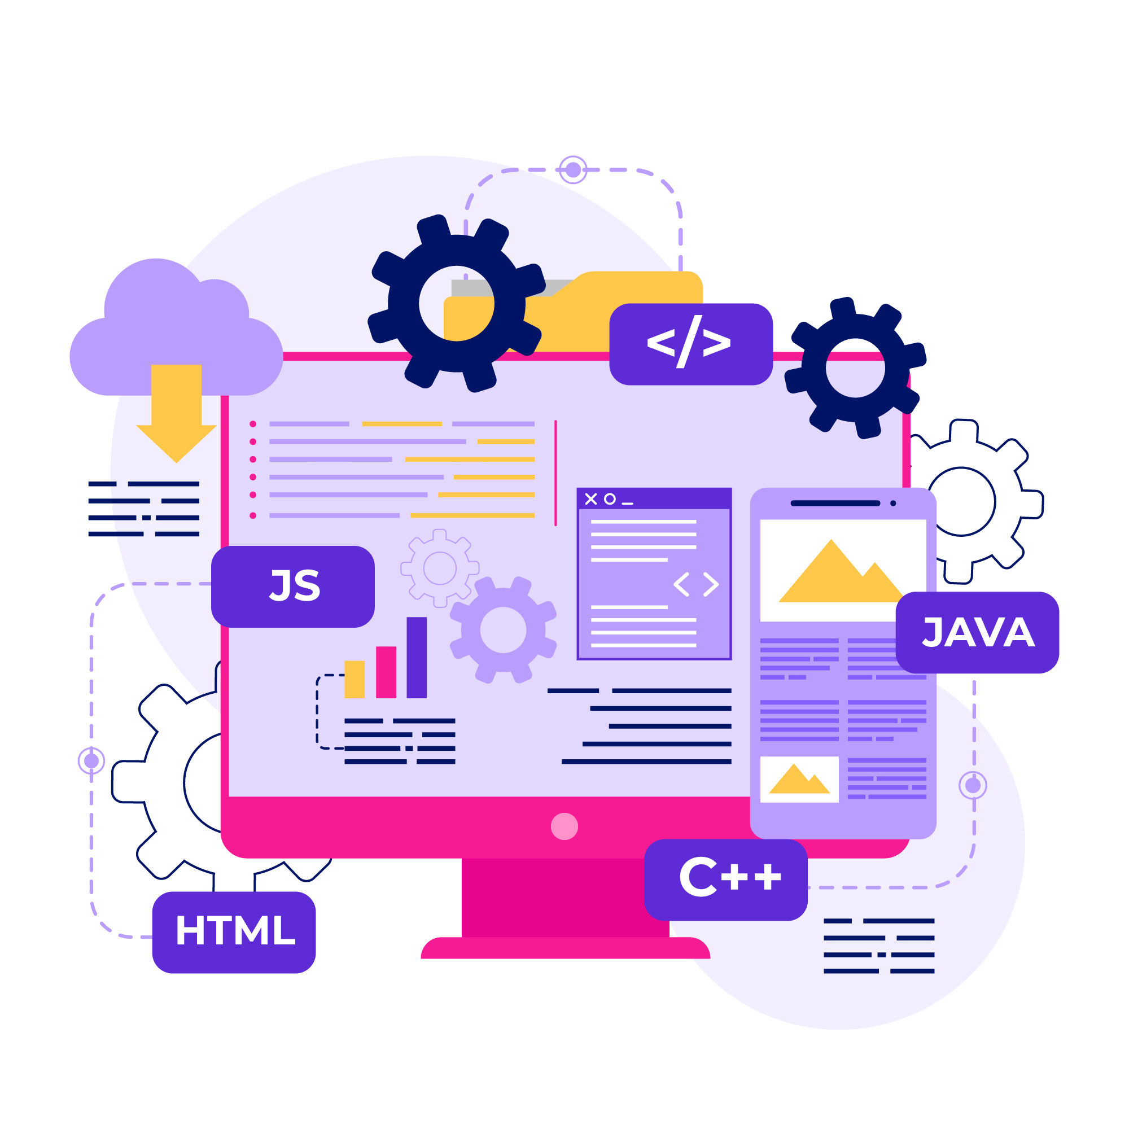
Computer Program
A compute program is like a recipe with a well-defined and orderly sequence of steps.​
A computer program requires data that we must provide for the program to return a result.
The order of steps or instructions in a program is very important.

Slide 9
Source Code
Humans write computer programs as plain text using a high-level programming language. This is known as source code.​
This is the human readable program written as plain text that developers build, which ultimately becomes machine code and is executed by the computer​.
Most languages have a set of constructs and features that are similar.​

Slide 10

Pop Quiz
Q. How do microprocessors (CPUs) understand instructions?
Through human-readable text
By interpreting high-level programming languages
Through graphical user interfaces (GUIs)
By processing Binary Code

Slide 11
Pop Quiz
Q. How do microprocessors (CPUs) understand instructions?
Through human-readable text
By interpreting high-level programming languages
Through graphical user interfaces (GUIs)
By processing Binary Code

Slide 12
How Does A Computer Program Work?

Slide 13
Source Code → Machine Code
Compilation
Using a Compiler

Slide 14

Compilation – Using a Compiler
A compiler is a software that converts source code into machine code.​​
The software developer works with a language that incorporates a compiler.
The developer writes the source code and compiles it for a specific type of platform because different kinds of platforms would require their own kind of machine code instructions.​

Slide 15


Compilation – Using a Compiler
This process of compilation is often referred to as the ‘build’ step. The result of compilation is machine code in an executable file, which is what the end user gets to run on their computer.
Build Step
Writes source code
Compiles to an executable
Developer

Slide 16
Compilation – Using a Compiler
This process is called ‘Ahead of Time’ compilation or AOT Compilation because the compilation is done in advance by the developer and not when the users want to run the program on their computers.
Build Step
Writes source code
Compiles to an executable
Developer
Ahead of Time Compilation

Slide 17


Source Code → Machine Code | Compiled Languages
Compiles to an executable
User
An Executable
(Windows)
Writes source code
User
Developer
Compiles to an executable
User
User
An Executable
(MacOS)
Ahead-Of-Time Compilation
User

Slide 18
Compilation – Using a Compiler
Programs compiled for specific platforms will not work on other kinds of platforms.
For example, software compiled for a Mac will not work on a PC running Windows and vice-versa.

Slide 19
Pop Quiz
Q. How does platform dependency impact compiled programs?
Compiled programs are universally compatible across all platforms
Programs compiled for specific platforms are interchangeable
Compiled programs work seamlessly on any platform
Platform dependency has no effect on compiled programs
Notes:
Note to the trainer: The learner might find this question confusing and tricky and might also opt for Question B or even C besides D as the correct answer. Here is how you should explain the reasons why D is the only right answer:
The physical smartphone: This is hardware. It's the tangible device you can touch.
The visual menu on the app: While you might think this is software, it's actually part of the user interface. It's the result of software, yes, but on its own, it's simply what you see because of the software.
The data about your order: This, too, seems like it could be the software. But it's not. The data is a product or by-product of the software's function. It's stored and managed by the software but isn't the software itself.
The set of instructions for the app's function: This is the heart of our answer. Software is all about the instructions written by developers that tell the hardware what to do. These instructions make up the app, enable it to display the menu, take your order, and communicate with the server to process your payment.
So when we talk about software, we're referring to this last point: the code, the commands, the digital blueprint that instructs your device on how to behave and respond to your inputs. It's invisible in its operation but visible through its effects, like the visual menu and the processed order.

Slide 20
Pop Quiz
Q. How does platform dependency impact compiled programs?
Compiled programs are universally compatible across all platforms
Programs compiled for specific platforms are interchangeable
Compiled programs work seamlessly on any platform
Platform dependency has no effect on compiled programs
Notes:
Note to the trainer: The learner might find this question confusing and tricky and might also opt for Question B or even C besides D as the correct answer. Here is how you should explain the reasons why D is the only right answer:
The physical smartphone: This is hardware. It's the tangible device you can touch.
The visual menu on the app: While you might think this is software, it's actually part of the user interface. It's the result of software, yes, but on its own, it's simply what you see because of the software.
The data about your order: This, too, seems like it could be the software. But it's not. The data is a product or by-product of the software's function. It's stored and managed by the software but isn't the software itself.
The set of instructions for the app's function: This is the heart of our answer. Software is all about the instructions written by developers that tell the hardware what to do. These instructions make up the app, enable it to display the menu, take your order, and communicate with the server to process your payment.
So when we talk about software, we're referring to this last point: the code, the commands, the digital blueprint that instructs your device on how to behave and respond to your inputs. It's invisible in its operation but visible through its effects, like the visual menu and the processed order.

Slide 21
Source Code → Machine Code
Interpretation
Using an Interpreter

Slide 22



Source Code → Machine Code
A Translator Interprets Language
🇺🇸
🇯🇵
English
Japanese
English
Japanese
Speaks only English
Translator
Speaks only Japanese

Slide 23
Interpreter
The Interpreter converts source-code to machine code during execution

Slide 24
Interpretation​ – Using an Interpreter
The other way to turn source code into machine code is interpretation or the use of an interpreter.​
The interpreter converts source code to machine code during the execution of the program. ​
In the case of interpreted languages like Python and JavaScript, the source code is given to the user.​

Slide 25
Interpreted Languages​
The user must have the language interpreter installed locally, which then takes the source code and executes it.
The developer does not need to compile executables for all possible environments because the platform specific nuances are handled by the language interpreter installed locally on the user’s computer.
Python on a Mac can execute the same source code as Python on Windows for most parts. Likewise, JavaScript written for websites and apps works universally across all kinds of platforms.​

Slide 26
Inside an Interpreter​
Inside modern interpreters, there will be a compiler that reads the source code and converts it into a highly optimized intermediate level version known as ‘bytecode’.
Such a compiler is known as a Just-in-Time compiler, which is the opposite of an ‘Ahead-of-Time’ compiler or compilation. The process is called a ‘Just-in-Time’ compilation.​
Bytecode is very efficient, but it isn’t low enough to qualify as machine code, and in many cases, it is platform independent.
For executing bytecode, different languages use different methods.

Slide 27

Source Code → Machine Code | Interpreted Languages
User
Writes source code
User
Developer
Source Code
User

Slide 28

Source Code → Machine Code | Interpreted Languages
Language Interpreter
User
Writes source code
Users need to have the language interpreter installed to execute code
Language Interpreter
User
Developer
Source Code
Language Interpreter
User

Slide 29



Inside an Interpreter
INTERPRETER
COMPILER
CONVERT BYTECODE TO MACHINE CODE
Just-In-Time
Compiler
Bytecode
Source Code
Machine Code
Highly optimized intermediate edition

Slide 30
Python
In Python, a virtual machine is integrated into the execution environment.​
A virtual machine is essentially a software component that simulates a uniform execution environment, and it takes the bytecode, implements platform specific optimizations, and finally executes it on the processor. ​

Slide 31


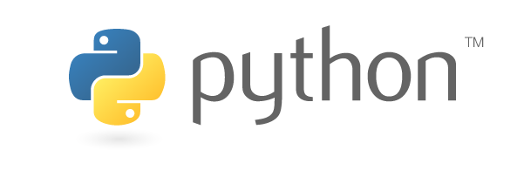
Inside an Interpreter | Python
PYTHON INTERPRETER
COMPILER
PYTHON VIRTUAL MACHINE
Machine Code
Just-In-Time
Compiler
Bytecode
SourceCode.py
Python source-code is first compiled to bytecode which is then executed by the Python Virtual Machine

Slide 32
JavaScript
In JavaScript, source code is interpreted, optimized, and turned into bytecode first by the Just-in-Time compiler, and then this bytecode is compiled into machine code and executed by a second compiler.
All of this contrasts with ahead of time compilation where an executable must be produced with all optimizations applied, for every platform.​

Slide 33

Inside an Interpreter | JavaScript
JAVASCRIPT INTERPRETER
COMPILER
BYTECODE COMPILER
Machine Code
Just-In-Time
Compiler
Bytecode
SourceCode.js
JavaScript source-code is compiled to bytecode and then compiled to machine code and executed

Slide 34
Compiler vs. Interpreter​
Interpreted languages may not be as performant as compiled code due to the runtime interpretation/compilation step. ​
However, this difference is consistently going down as interpreted languages evolve and become more efficient.​

Slide 35

Compiler vs. Interpreter
THE DEVELOPER
THE USER
AHEAD OF TIME
DURING RUNTIME
COMPILED LANGUAGES SUCH AS C++ AND RUST
COMPILATION
Source Code
An Executable
INTERPRETED LANGUAGES SUCH AS PYTHON AND JAVASCRIPT
COMPILE TO BYTECODE > COMPILE BYTECODE TO MACHINE CODE & EXECUTE
INTERPRETER
Source Code
Interpreted languages may not be as performant as compiled code due to runtime interpretation/compilation step

Slide 36
Another Class of Languages
There is a third category of languages where the source code is compiled ahead of time to bytecode during the build step.
Bytecode is an intermediate stage code that is highly optimized but is not low level enough to run directly on the processor.
In many cases, it can be platform agnostic which is unlike compiled languages where you must compile for a specific platform.

Slide 37
Yet Another Class of Languages
THE DEVELOPER
THE USER
AHEAD OF TIME
DURING RUNTIME
Virtual Machine
COMPILATION
Compile ByteCode to Machine Code & Execute
Source Code
Bytecode

Slide 38
Java
A Java developer writes code and compiles it to bytecode, ahead-of-time. This bytecode edition is what the end user gets.
This is different from compiled languages and interpreted languages.
In the case of Java, the bytecode edition is neither source code nor directly executable.​​

Slide 39
Java
At the user end, the Java Virtual Machine or JVM needs to be installed.
The JVM takes the bytecode file and uses a Just-in-Time compiler to convert it to optimized machine code specific to the platform and executes it.
​The virtual machine environment manages the platform specific compilation duties by using bytecode – a highly optimized low version of the code that can be taken across from midway to full compilation and execution.​
Java Bytecode is highly optimized and can be executed wherever a compatible Java Virtual Machine (JVM) is available.​

Slide 40

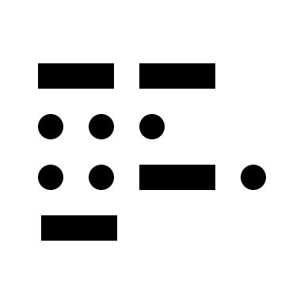
Java
Bytecode
User
Writes source code
Compiles to bytecode
User
Developer
MyApp.class
User

Slide 41
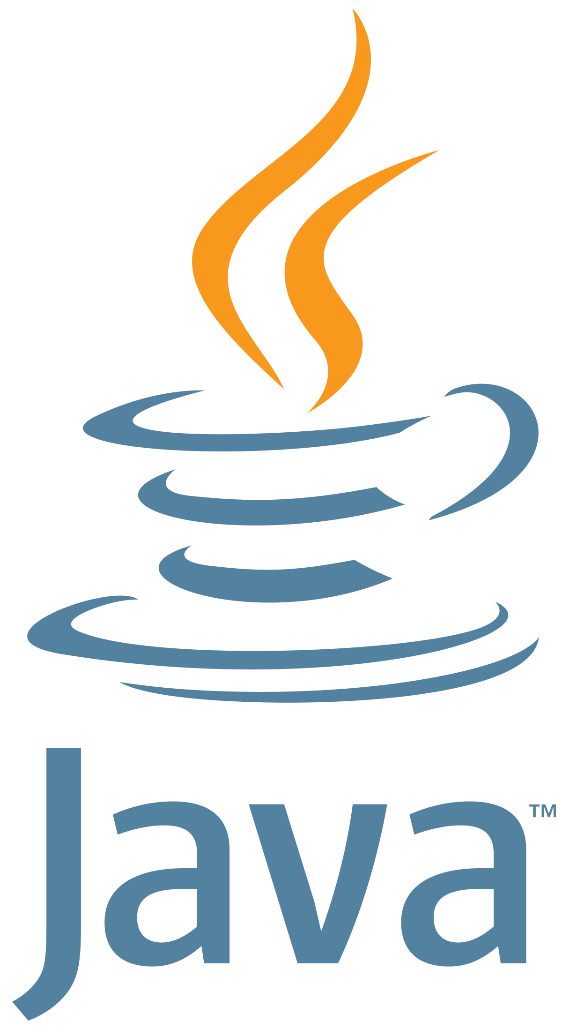
Java
Java
Virtual Machine
Bytecode
User
Writes source code
Compiles to bytecode
Java
Virtual Machine
User
Developer
MyApp.class
Java
Virtual Machine
User

Slide 42
Java
Java
Virtual Machine
Java Bytecode is highly optimized and can be executed wherever a compatible Java Virtual Machine (JVM) is available
MyApp.class

Slide 43
Pop Quiz
Q. What is the purpose of a Just-in-Time compiler in modern interpreters?
It converts bytecode into machine code during development.
It produces executables with all optimizations applied for every platform.
It reads the source code and converts it into bytecode during program execution.
It converts the source code into a highly optimized intermediate level version known as bytecode.

Slide 44
Pop Quiz
Q. What is the purpose of a Just-in-Time compiler in modern interpreters?
It converts bytecode into machine code during development.
It produces executables with all optimizations applied for every platform.
It reads the source code and converts it into bytecode during program execution.
It converts the source code into a highly optimized intermediate level version known as bytecode.

Slide 45
Pop Quiz
Q. How does Python handle the execution of bytecode in the interpreter?
Python uses an Ahead-of-Time compiler for bytecode execution.
Python relies on a second compiler for executing bytecode.
Python integrates a virtual machine into the execution environment, which takes the bytecode and executes it on the processor.
Python interprets source code directly without converting it to bytecode.

Slide 46
Pop Quiz
Q. How does Python handle the execution of bytecode in the interpreter?
Python uses an Ahead-of-Time compiler for bytecode execution.
Python relies on a second compiler for executing bytecode.
Python integrates a virtual machine into the execution environment, which takes the bytecode and executes it on the processor.
Python interprets source code directly without converting it to bytecode.

Slide 47
Defining a Computer Program

Slide 48

Defining a Computer Program
A Computer program is like a recipe with a well-defined and orderly sequence of steps.
It has client and server-based operating systems.

Slide 49
Understanding Source Code

Slide 50
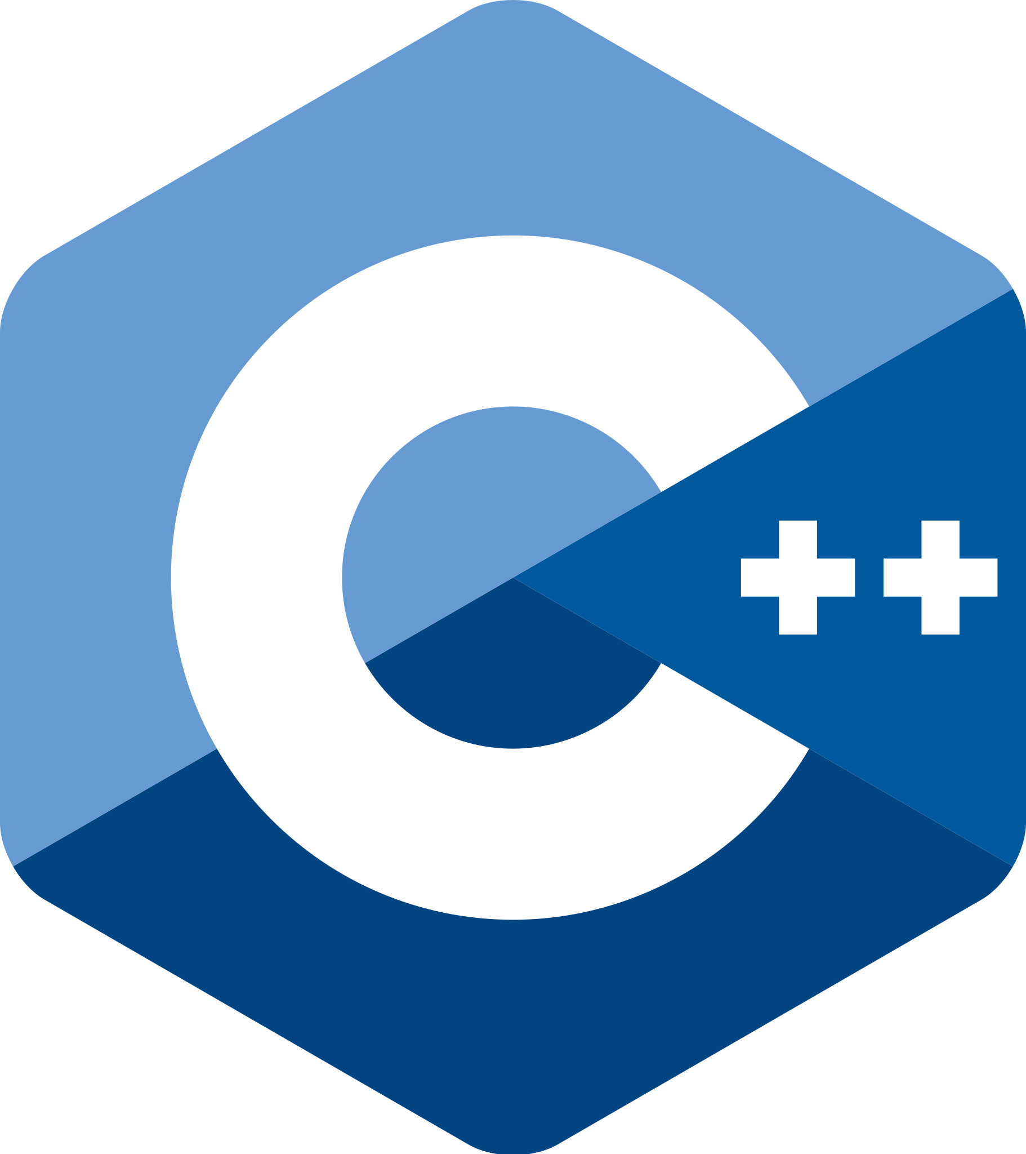
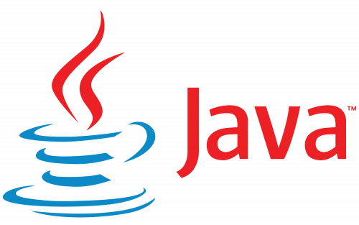

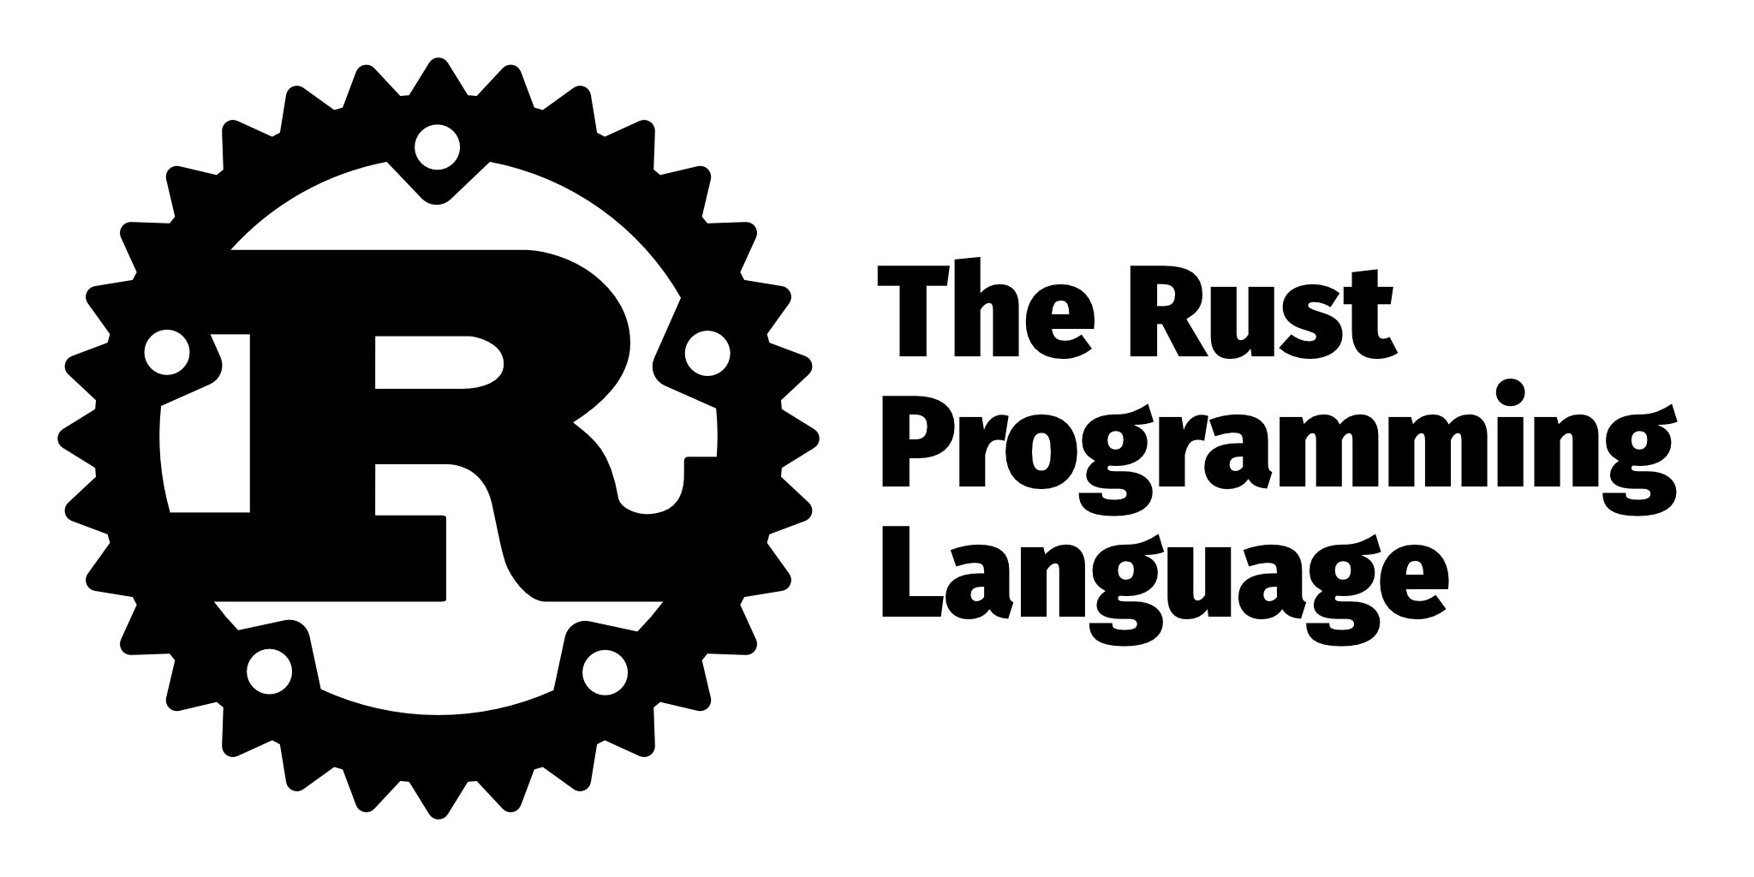
Source Code
Source Code
SOURCE CODE FOR COMPUTING THE AVERAGE OF 3 NUMBERS
PYTHON
def averageOfThree(a, b, c):
return (a + b + c) / 3
JAVASCRIPT
function averageOfThree(a, b, c) {
return (a + b + c) / 3;
}
We write computer programs using high-level languages in human-readable plain text!

Slide 51
Source Code → Machine Code
Source Code to Machine Code
SOURCE CODE
YOUR PROCESSOR NEEDS
High Level Language
Machine Code
We work with high-level languages to write computer programs that are ultimately converted to low-level machine code

Slide 52
A COMPUTER PROGRAM
Inside a Computer Program
A PROGRAM
FUNCTION
VARIABLES
VARIABLES
LOOPS
CONDITIONAL
CALL → FUNCTION
FUNCTION
VARIABLES
CONDITIONAL
CALL → FUNCTION
Programming Languages offer features & building blocks that you put together in a logical manner to build a program

Slide 53
Understanding Syntax

Slide 54
Syntax - Keywords
A set of rules that must be followed when using a programming language.
These rules are critically important for the program to work correctly and differ from language to language.
Keywords: Specific words that are part of the programming language. They act like tokens of instruction that you can put together to form a program.
Case Sensitivity: Case sensitivity is also one of the first few things where beginners tend to make mistakes.
Statements: It is important for the programming language to know where a statement begins and where it ends.

Slide 55
Syntax - Keywords
No curly braces, no semi-colons: Python uses indentation to define blocks and line breaks to define the end of statements.
A lexer converts source code into recognizable tokens as per the grammar of the language.
The parser takes these tokens and constructs a tree of tokens representing the logical form of the program so that the code makes sense with respect to the rules of the language.

Slide 56
Syntax - Keywords
Curly braces are often used to define start and end of statements.
A pair of opening and closing curly braces defines a block of code.
End of statements: They're the same except for code formatting and readability.

Slide 57
SYNTAX - KEYWORDS
Syntax - Keywords
These are reserved keywords in C++, Java, JavaScript & Python
You cannot use such keywords for expressing your data
if (temperature > 15) {
console.log("It is warm");
} else {
console.log("It is cold");
}

Slide 58
SYNTAX - KEYWORDS
Syntax - Keywords
This is a reserved keyword in JavaScript
function isItWarm(temperature) {
if (temperature < 15) {
return "It is cold";
} else {
return "It is warm";
}
}

Slide 59
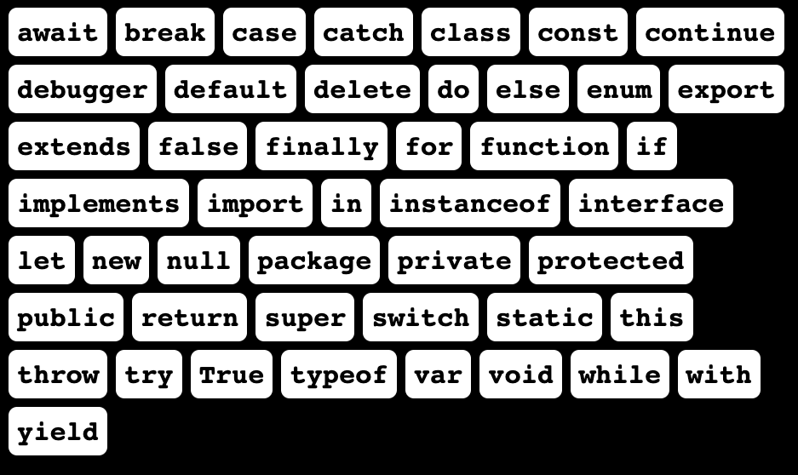
SYNTAX - KEYWORDS
A list of reserved keywords in JavaScript

Slide 60
SYNTAX - CASE SENSITIVITY
Case-Sensitivity
An apple is not the same as an Apple

Slide 61


SYNTAX - CASE SENSITIVITY
if (temperature > 15) {
console.log("It is warm");
}
If (temperature > 15) {
console.log("It is warm");
}
IF (temperature > 15) {
console.log("It is warm");
}

Slide 62
SYNTAX - CASE SENSITIVITY
This should be if and not IF
IF (temperature > 15) {
console.log("It is warm");
}
Ignoring the right case will throw errors

Slide 63
SYNTAX
Statements
It is important for the programming language to know where a statement begins and where it ends

Slide 64
SYNTAX - BLOCK
JAVA
class Main {
public static void main(String[] args) {
float temperature = 12;
if (temperature < 15) {
System.out.println("It's cold!");
} else {
System.out.println("It's warm!");
}
}
}
Curly braces are often used to define start and end of statements

Slide 65
SYNTAX - BLOCK
JAVA
class Main {
public static void main(String[] args) {
float temperature = 12;
if (temperature < 15) {
System.out.println("It's cold!");
} else {
System.out.println("It's warm!");
}
}
}
BLOCK
BLOCK
BLOCK
BLOCK
A pair of opening & closing curly braces defines a block of code

Slide 66
SYNTAX - END OF STATEMENTS
JAVA
class Main {
public static void main(String[] args) {
float temperature = 12;
if (temperature < 15) {
System.out.println("It's cold!");
} else {
System.out.println("It's warm!");
}
}
}

Slide 67
SYNTAX - INDENTATION & FORMATTING
JAVA
JAVA
class Main {
public static void main(String[] args) {
float temperature = 12;
if (temperature < 15) {
System.out.println("It's cold!");
} else {
System.out.println("It's warm!");
}
}
}
class Main {
public static void main(String[] args)
{float temperature = 12;if (temperature < 15)
{System.out.println("It's cold!");}
else { System.out.println("It's warm!"); }}}
They're the same except for code formatting & readability

Slide 68
SYNTAX - INDENTATION & FORMATTING
JAVA
JAVA
class Main {
public static void main(String[] args) {
float temperature = 12;
if (temperature < 15) {
System.out.println("It's cold!");
} else {
System.out.println("It's warm!");
}
}
}
class Main {
public static void main(String[] args)
{float temperature = 12;if (temperature < 15)
{System.out.println("It's cold!");}
else { System.out.println("It's warm!"); }}}
They're the same except for code formatting & readability

Slide 69
SYNTAX - NO CURLY BRACES & NO SEMI-COLONS
PYTHON
temperature = 12
if temperature < 15:
print("It's cold!")
else:
print("It's warm!")
Python uses indentation to define blocks and line-breaks to define end of statements

Slide 70
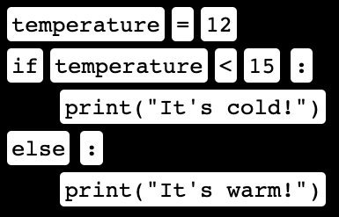
LEXER
temperature = 12
if temperature < 15:
print("It's cold!")
else:
print("It's warm!")
A lexer converts source-code into recognizable tokens as per the grammar of the language

Slide 71

PARSER
PARSER
SYNTAX ANALYSIS
The parser takes these tokens and constructs a tree of tokens representing the logical form of the program so that the code makes sense as per the rules of the language

Slide 72
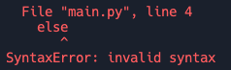
IMPORTANT
Attention to Detail
temperature = 12
if temperature < 15:
print("It's cold!")
else
print("It's warm!")

Slide 73
Pop Quiz
Q. What is the purpose of source code in a computer program?
To confuse programmers
To obfuscate instructions
To express instructions in a user-friendly manner
To serve as decorative elements

Slide 74
Pop Quiz
Q. What is the purpose of source code in a computer program?
To confuse programmers
To obfuscate instructions
To express instructions in a user-friendly manner
To serve as decorative elements

Slide 75
Data Types

Slide 76
Importance of Data Types
To process and store data, a programming language needs to know the type of data.

Slide 77
Primitive Data Types
Primitive data types are built-in data types used to express the data.
Numbers
Boolean
Integers: Whole numbers without a decimal point.
Boolean values can either be true or false.
Floating points or floats: Numbers with a decimal point.
Most of the decision-making relies on the Boolean value.
Strings: Group of characters to represent a name.
For instance, to decide whether to switch between enable and disable the processing of some data.

Slide 78
Primitive Data Types
Primitive data types are built-in data types used to express the data.
Nothing
String
Nothing represents the absence of data.
Strings are group of characters.
Null, nothing, undefined, and other data represent the lack of data.
Strings represent names, social media posts, email IDs, postal addresses, blog posts, etc.
This is essential when the program needs to process only when the data is present.
For instance, to decide whether to switch between enable and disable the processing of some data.

Slide 79
Pop Quiz
Q. Which of the following is a primitive data type?
Array
Object
Integer
Function

Slide 80
Pop Quiz
Q. Which of the following is a primitive data type?
Array
Object
Integer
Function

Slide 81
Variables

Slide 82
What are variables?
Variables are like buckets which hold data in a computer program

Slide 83
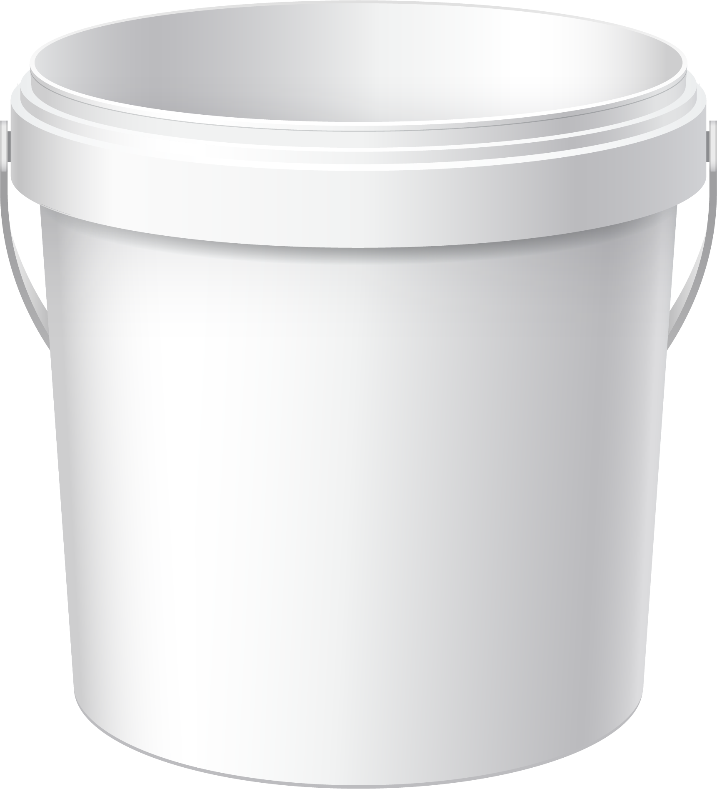
Variables
Variables
VARIABLES ARE LIKE BUCKETS THAT HOLD DATA
3.1415
pi
NAME
DATA TYPE
VALUE
A Variable holds a value

Slide 84
Variables
Variables are used to store the data in the computer memory before it gets processed.
Assignment operator: It takes the value on the right and assigns it to the variable on the left.
This creates a variable.
This is the value.
let
pi
=
3.1415
The variable name is defined by the developer and is used to fetch or modify the value.
The above example show the components of a variable.

Slide 85
Variables | JavaScript
A PROGRAM TO COMPUTE THE AREA OF A CIRCLE
let pi = 3.1415
let radius = 25
$${πr}^{2}$$
let area = pi * radius ** 2
Multiplication Operator
Exponentiation Operator
RESULT
1963.4375

Slide 86
Variables | JavaScript
let cost = 20.35
let user = "John Doe"
let isAdmin = false

Slide 87
Variables | Java
float cost = 20.35
String user = "John Doe"
boolean isAdmin = false

Slide 88
Naming a Variable
Variable names must not begin with a number.
Variable names must be meaningful.
In practice, begin the variable name with a lower-case character.
If the variable has two words, then begin the first word with a small letter and the second word with an upper case. Alternatively, use an underscore to separate the words.

Slide 89
Naming Variables
let 04Login = true
Variable names must not begin with a number

Slide 90

Naming Variables
let DL_Login_Conf = true
let isLoggedIn = true
Variable names must be easy to understand and meaningful

Slide 91
Naming Variables
let cost = 45.30
SINGLE WORDS
let radius = 20
let isLoggedIn = true
MULTIPLE WORDS
let userManager = "John"
Use camelCased variable names for easy readability

Slide 92
Naming Variables
let cost = 45.30
SINGLE WORDS
let radius = 20
let is_logged_in = true
MULTIPLE WORDS
let user_manager = "John"
You cannot use spaces between words, but can use underscores

Slide 93
Pop Quiz
Q. Which of the following is a valid variable name according to the naming conventions mentioned?
123variable
firstName
first---Variable
Variable-Name

Slide 94
Pop Quiz
Q. Which of the following is a valid variable name according to the naming conventions mentioned?
123variable
firstName
first---Variable
Variable-Name

Slide 95
Summary
Unveiled the essentials of computer programming and its significance in driving technology.
Peered into the structure of a computer program and the intricate dance of logic it performs.
Explored how computer programs come alive, turning raw code into action.
Delved into the grammar of programming - syntax, and how it forms the backbone of source code.
Discussed the various data types and their role in representing information in a program.
Introduced variables as the fundamental elements for storing and manipulating data.

Slide 96



Slide 97
Thank You
Copyright © Upgrad., All rights reserved
Confidential Information, intended for approved distribution list of Upgrad

